Slide 1


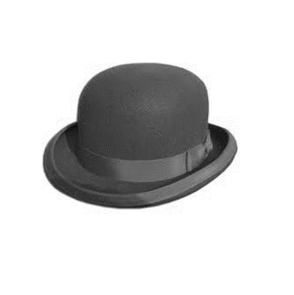

Learning for first associates (Targets)
sand
sand
(Two cycles)
?
Learning for second associates (Competitors)
sand
sand
(One cycle)
?
Final 2AFC
recognition test
Selective retrieval
sand
F – O – S - ?

